Slide 1
A MINI PROJECT ON
ATTENDANCE MANAGEMENT SYSTEM
by
SWATI: 1RN16IS111
SANAT: 1RN16IS084
Guide
Prof. T S Bhagavath Singh
FACULTY INCHARGE
Mrs. Kusuma S

Slide 2
INTRODUCTION
Attendance management system deals with the maintenance of the student attendance detail based on the presence of student in class.

Slide 3
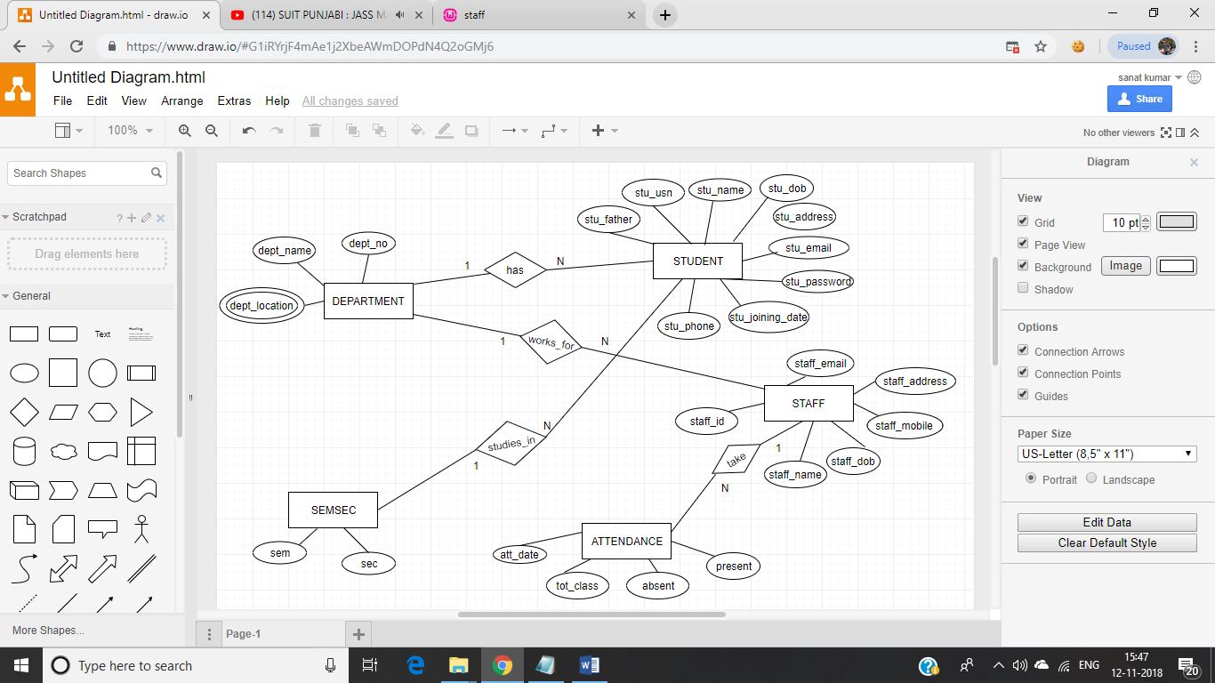
E-R DIAGRAM

Slide 4
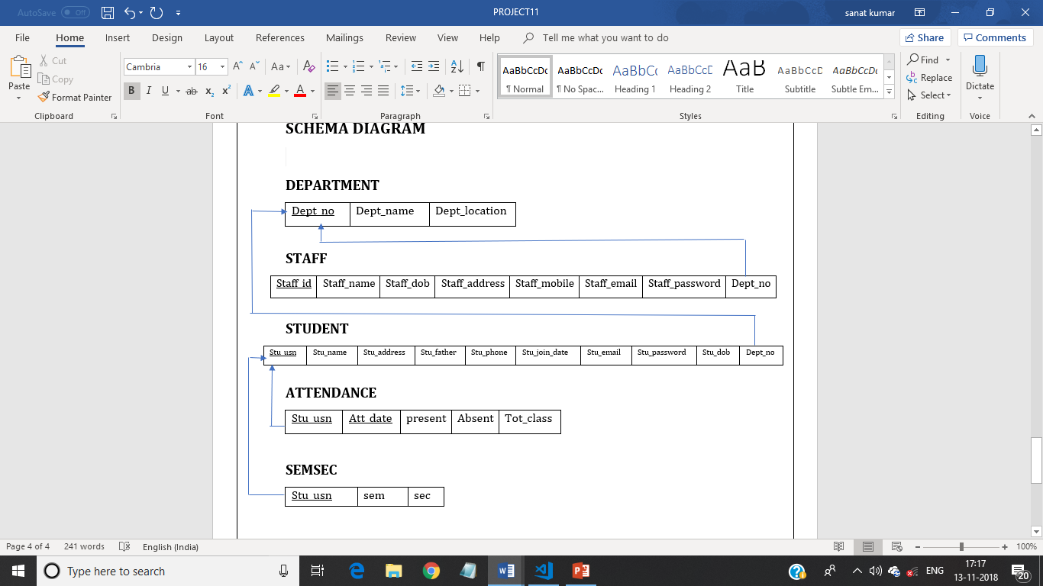
SCHEMA DIAGRAM

Slide 5
SOFTWARE AND HARDWARE REQUIREMENTS
SOFTWARE REQUIREMENTS
HARDWARE REQUIREMENTS
Front end tool: HTML,PHP,CSS
Back end: Oracle MYSQL 10G
Processor: Pentium IV and above
Processor Speed: 1.4 GHz
Cache size: 1024 KB
RAM: 1 GB
Hard Disk: 1 TB
Apache Tomcat with port no. 8080

Slide 6
CHARACTERISTICS OF THE SYSTEM
User Friendly:- The proposed system is user friendly because the retrieval and storing of data is fast and data is maintained efficiently.
Reports are easily generated: Reports can be easily generated in the proposed system so, user can generate the report as per the requirement (monthly) or in the middle of the session. User can give the notice to the students so he/she become regular.
Very less paper work: The proposed system requires very less paper work. All the data is feted into the computer immediately and reports can be generated through computers.
Computer operator control: Computer operator control will be there so no chance of errors. Moreover storing and retrieving of information is easy. So work can be done speedily and in time.

Slide 7
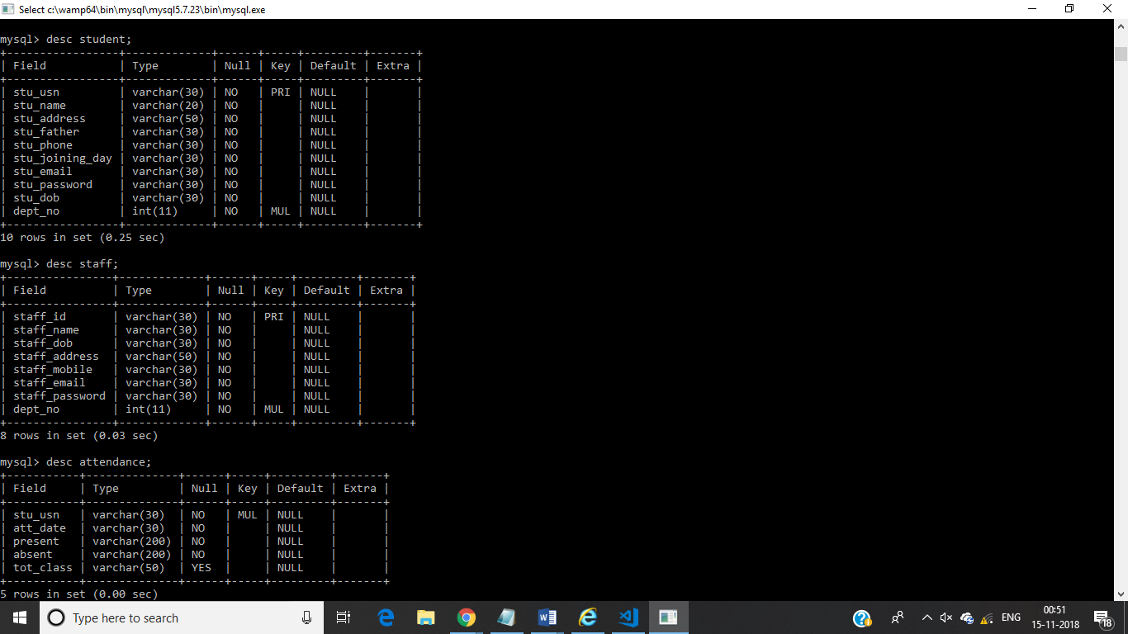
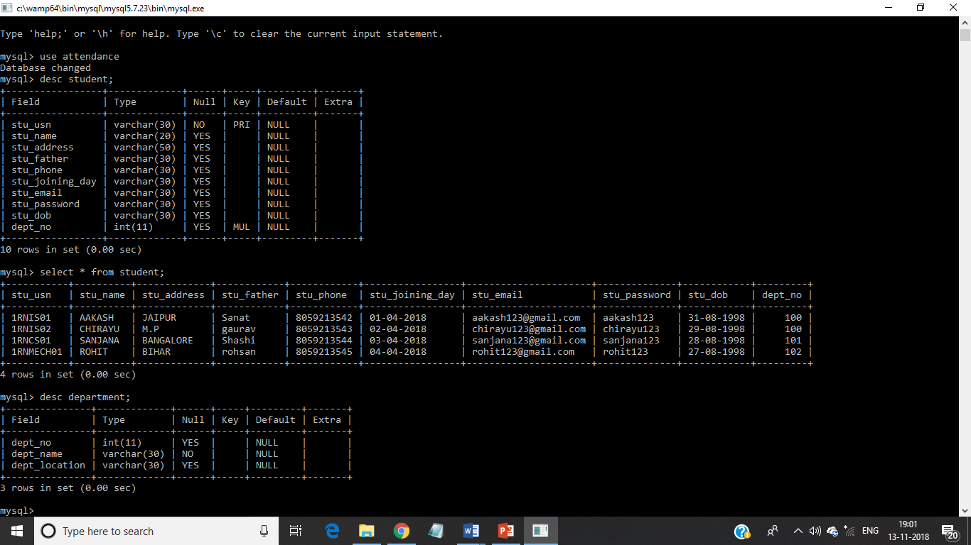
SNAPSHOTS(BACKEND)
TABLE:STUDENT

Slide 8
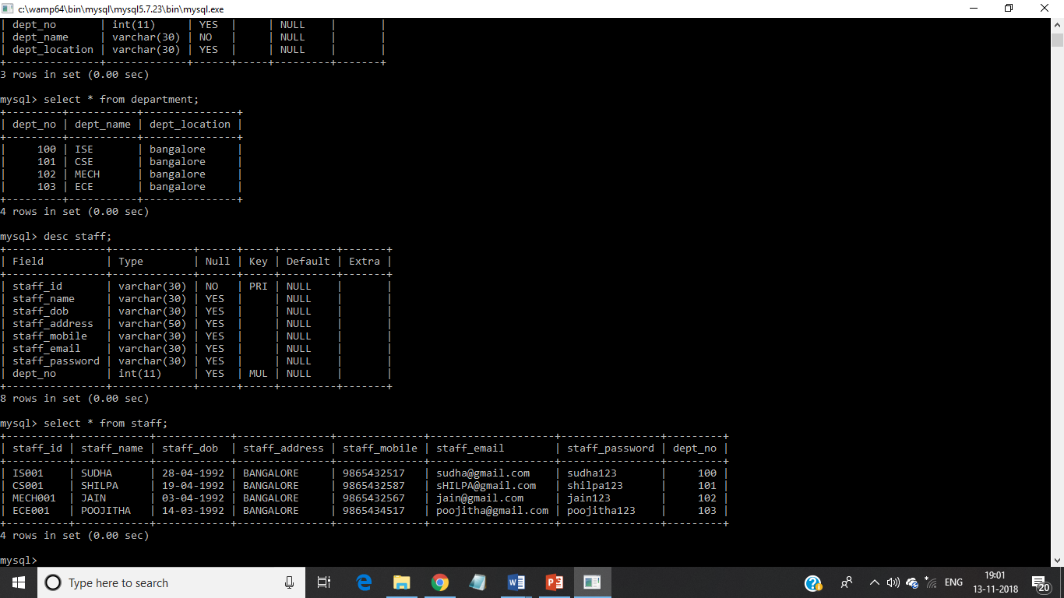
SNAPSHOTS (BACKEND)
TABLE:DEPARTMENT

Slide 9
SNAPSHOTS (BACKEND)
TABLE:STAFF

Slide 10
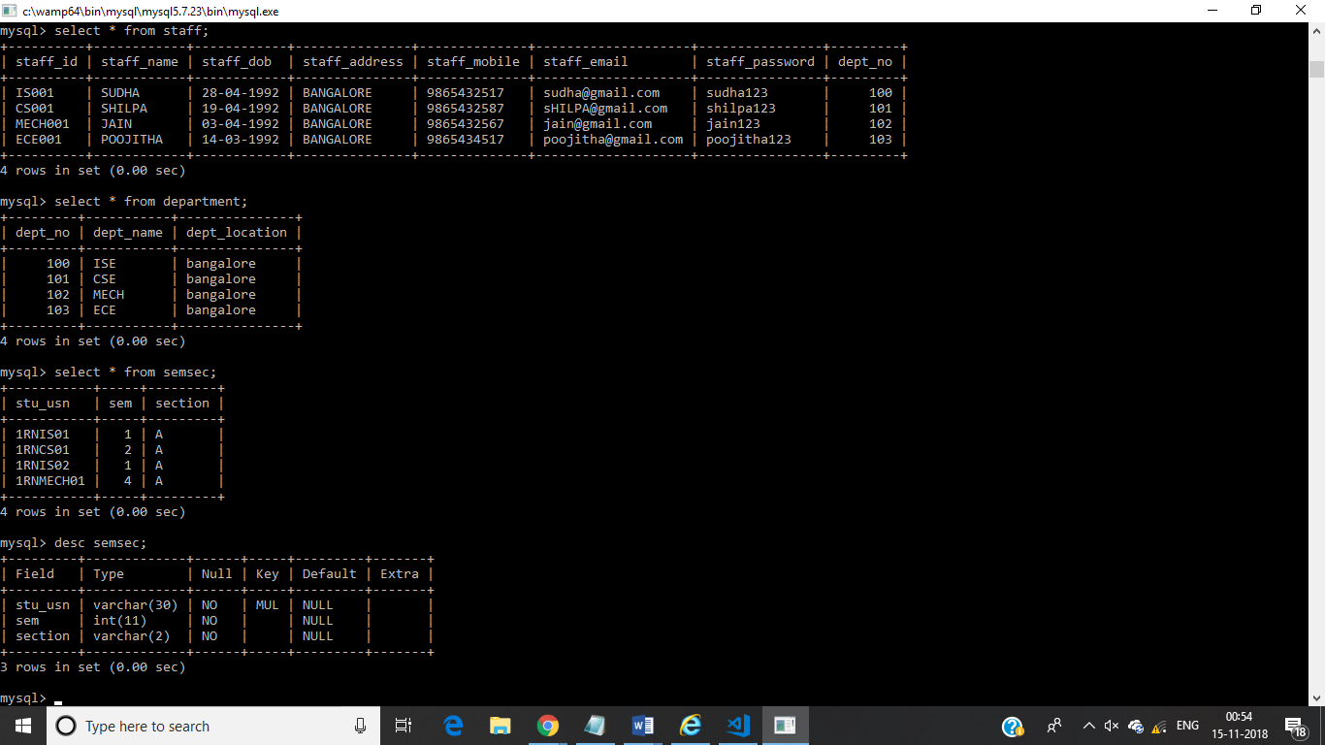
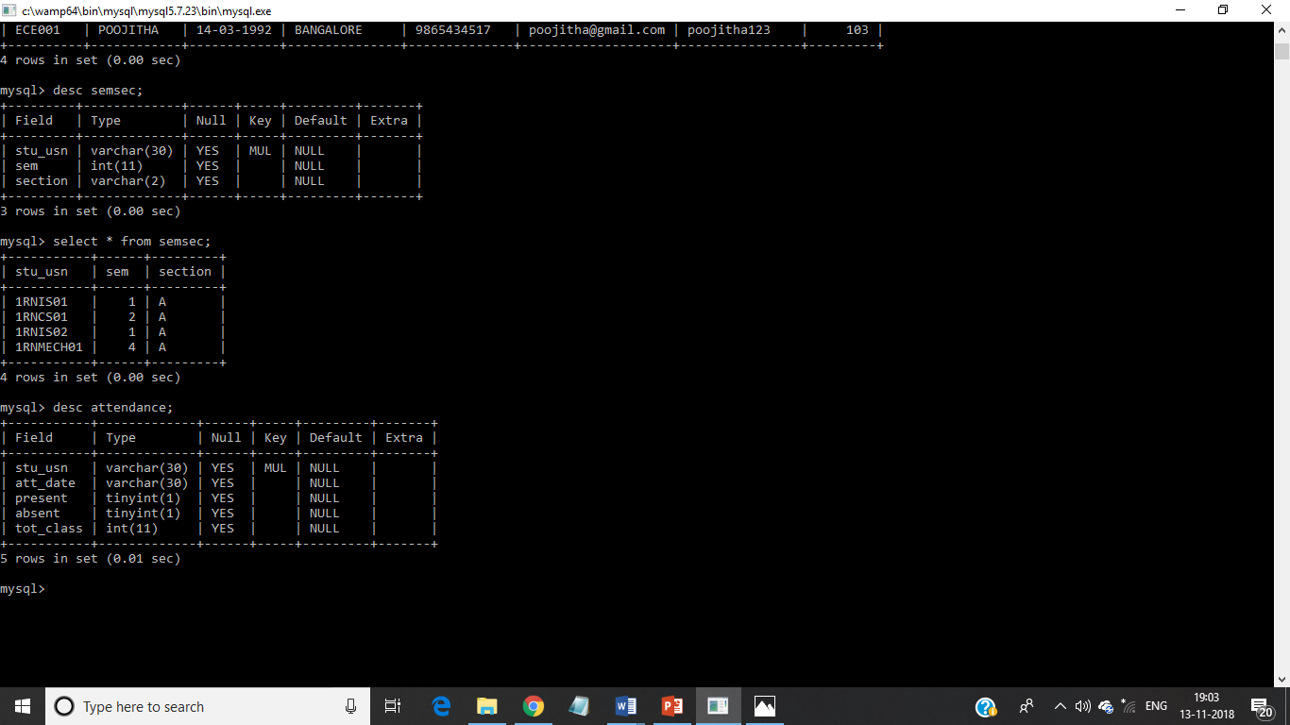
SNAPSHOTS (BACKEND)
TABLE:SEMSEC

Slide 11

SNAPSHOTS (BACKEND)
TABLE:ATTENDANCE

Slide 12
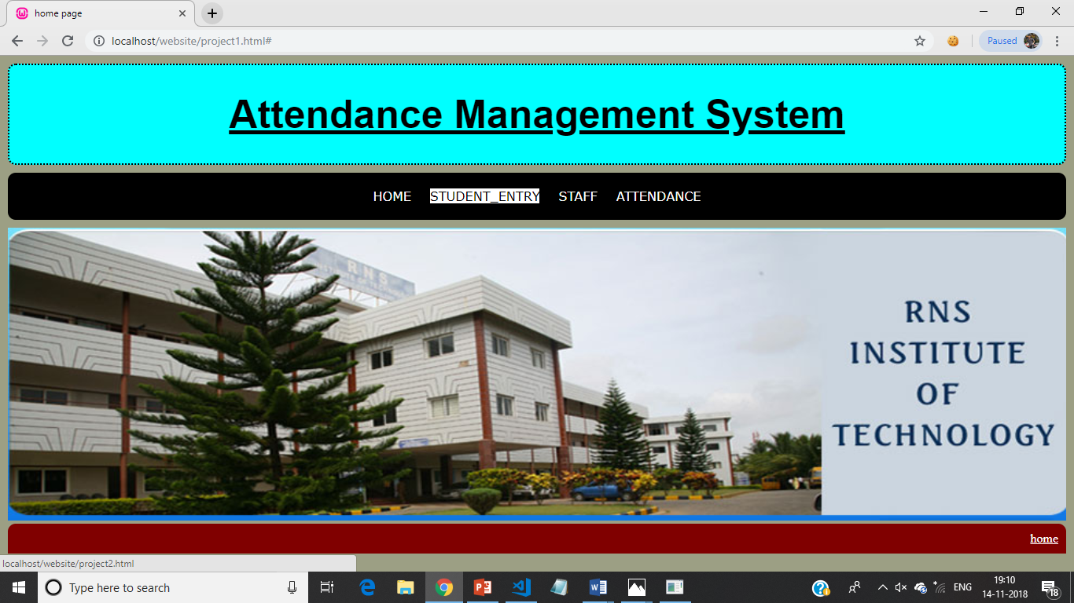
SNAPSHOTS (FRONTEND)
HOME PAGE

Slide 13
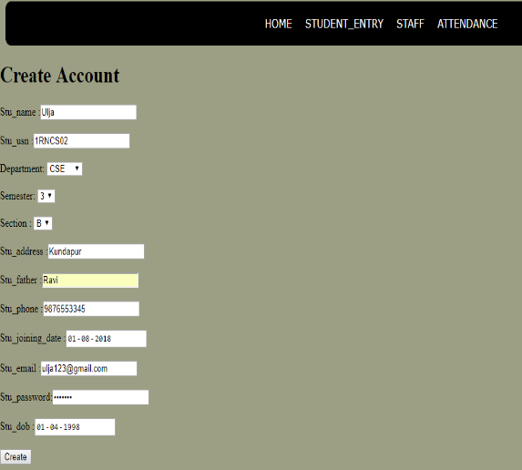
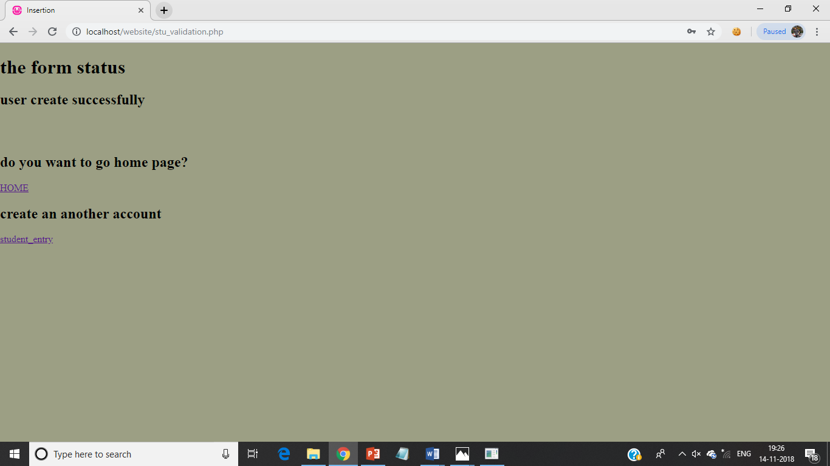
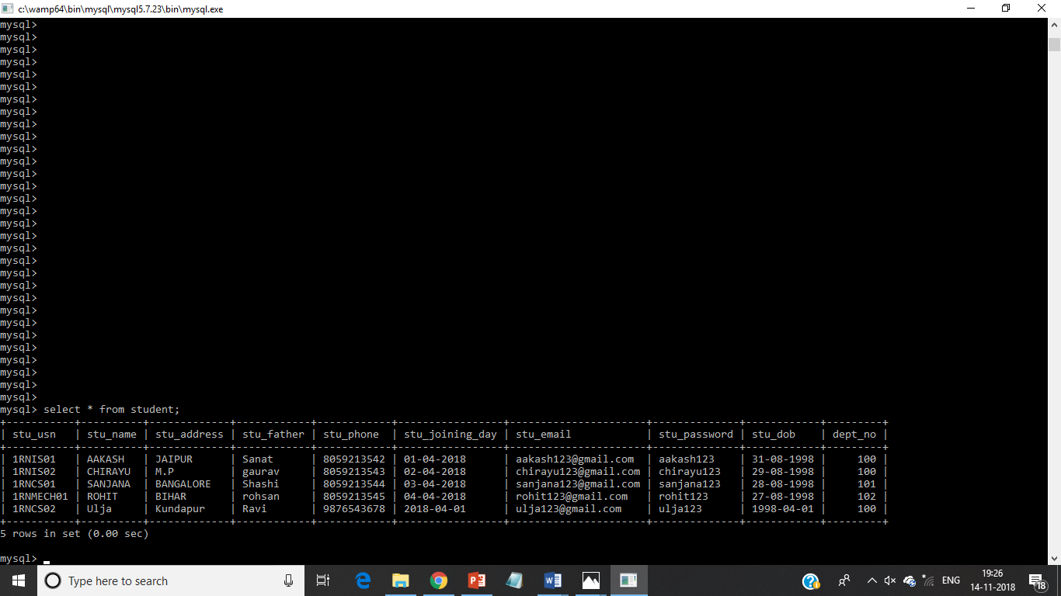
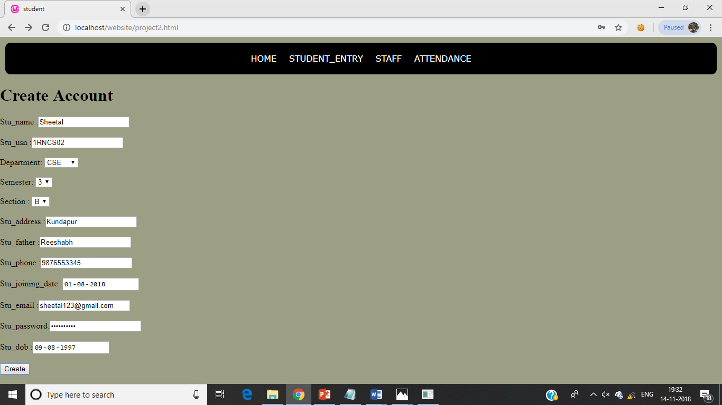

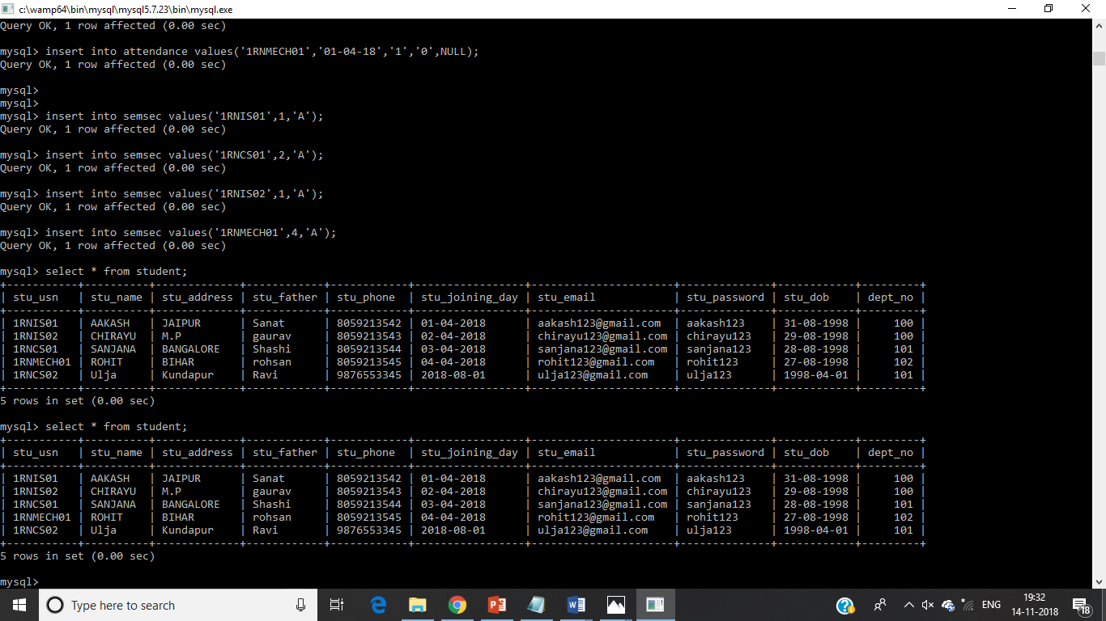
SNAPSHOTS (FRONTEND)

Slide 14
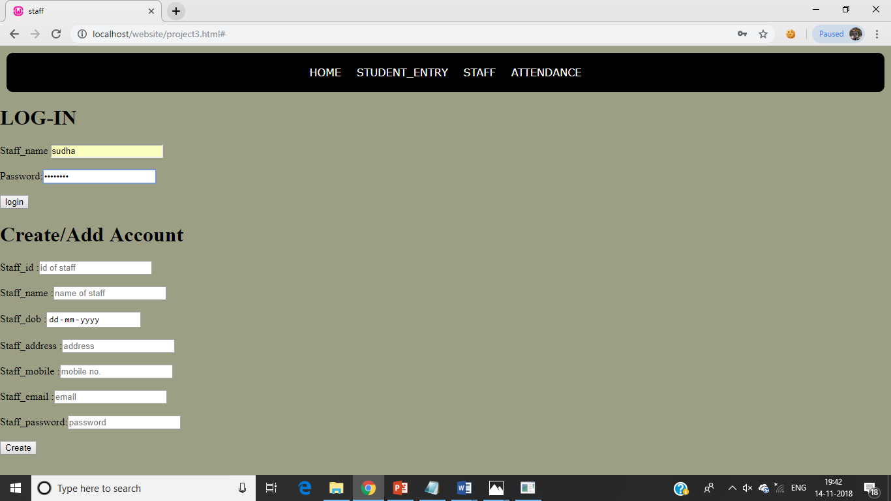
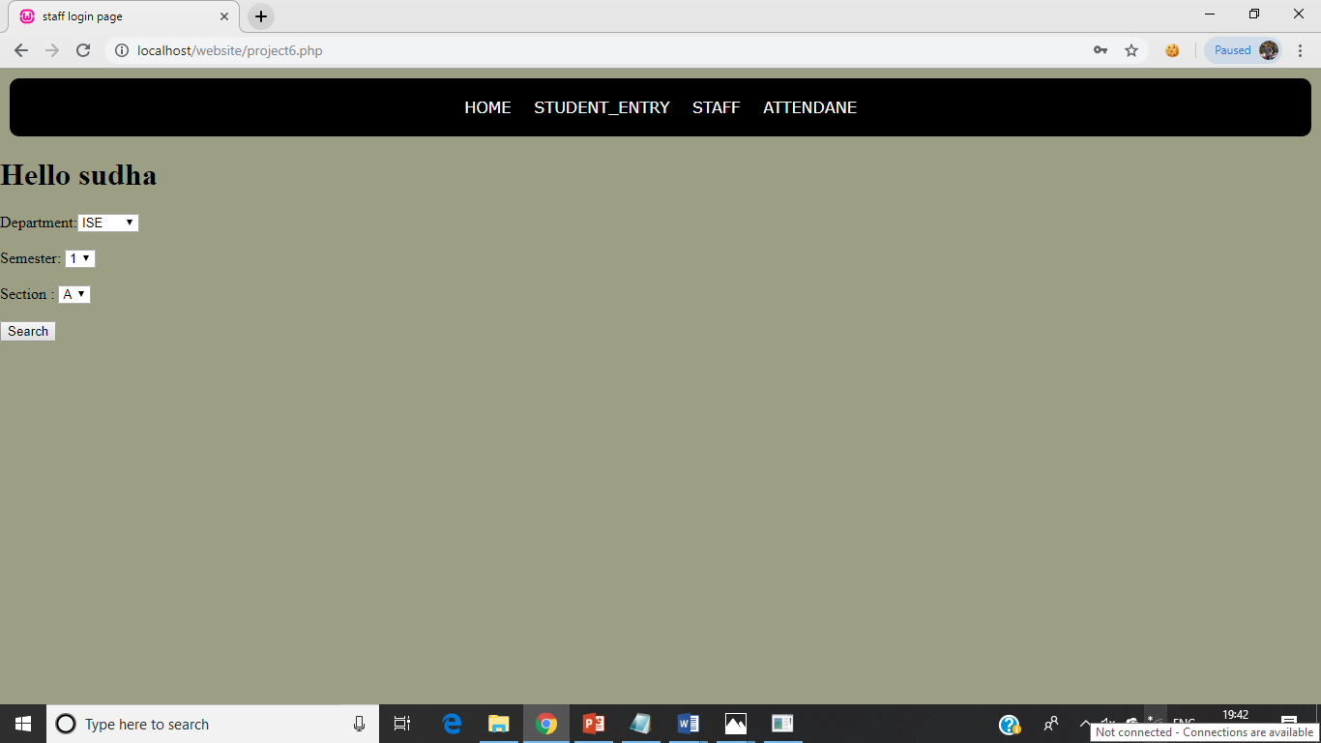
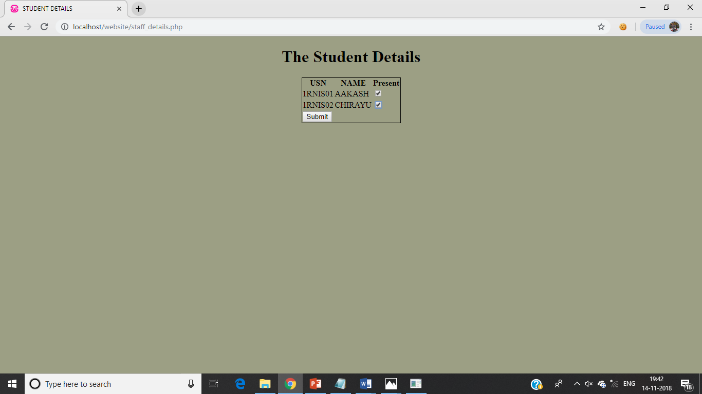
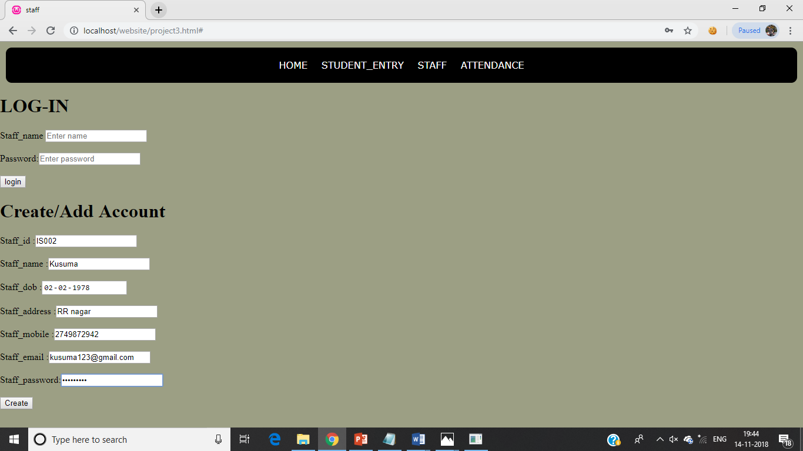
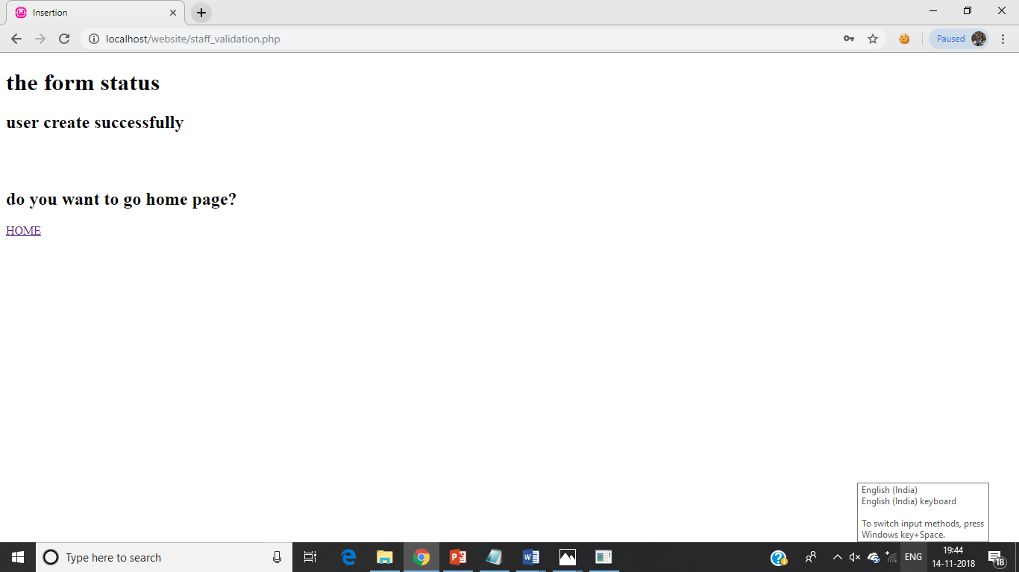
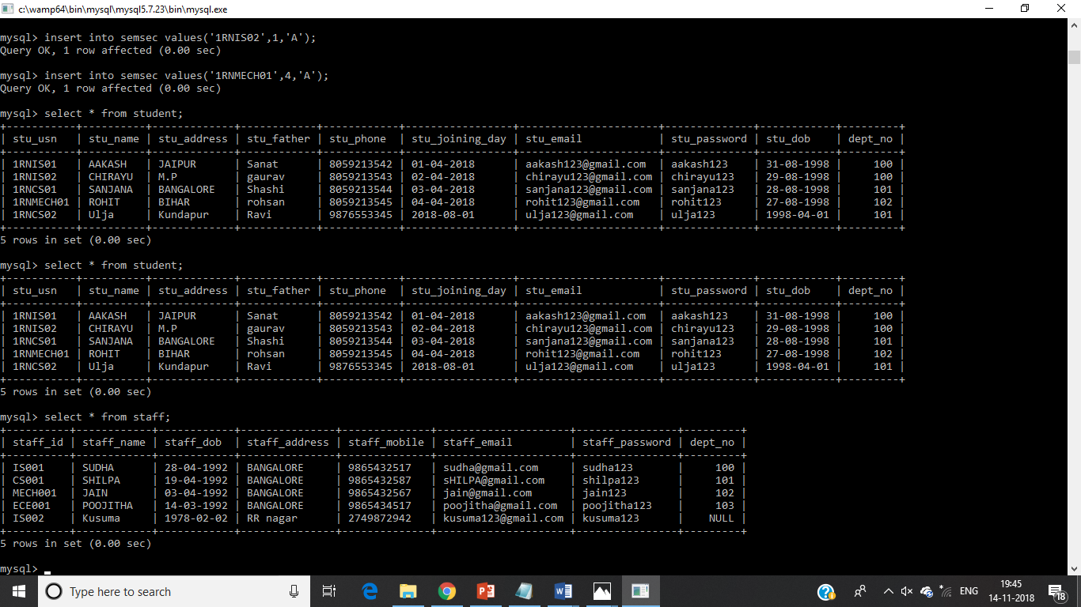
SNAPSHOTS (FRONTEND)

Slide 15
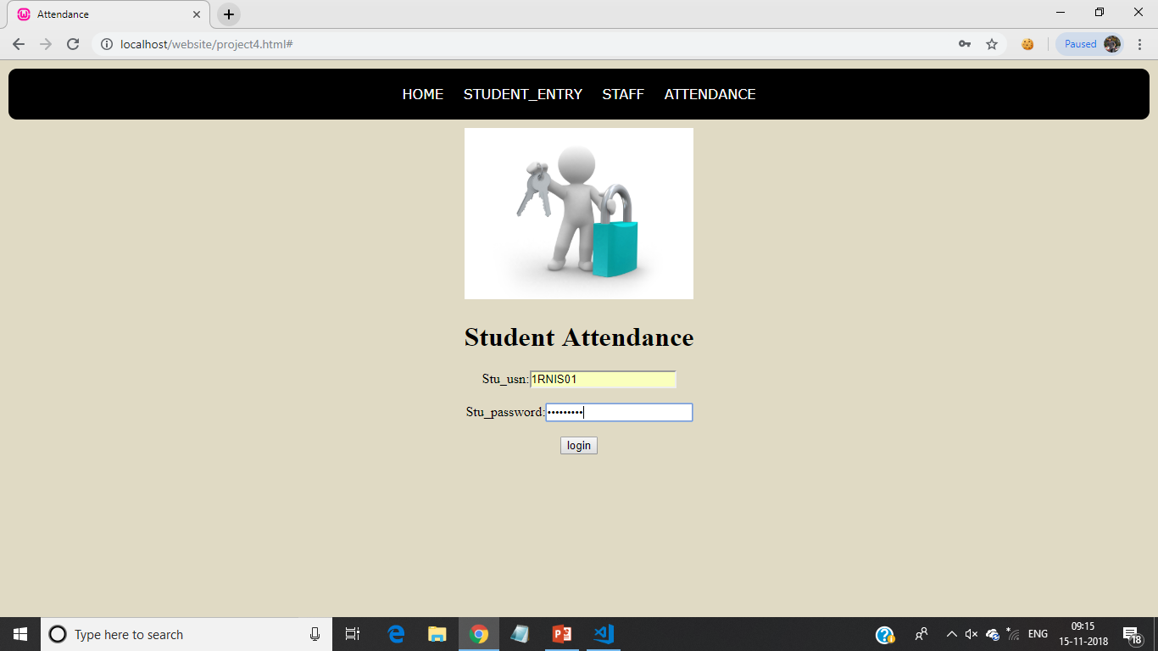
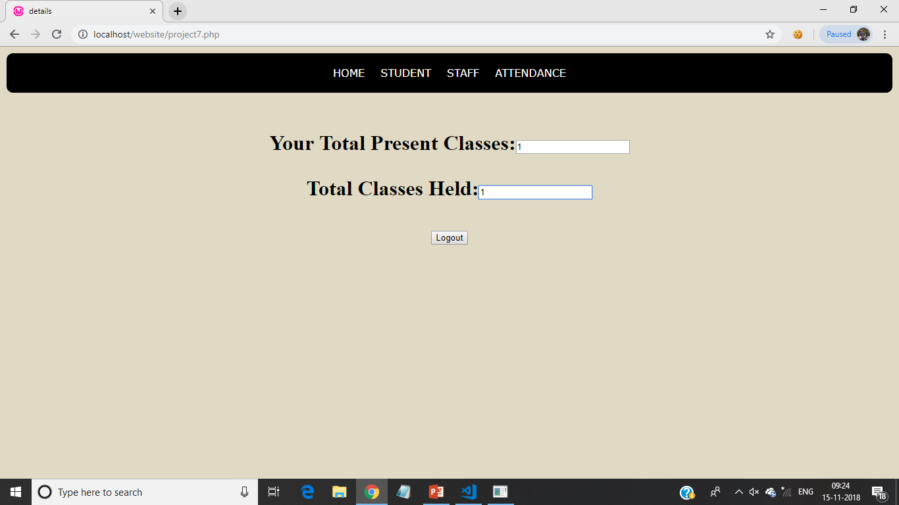
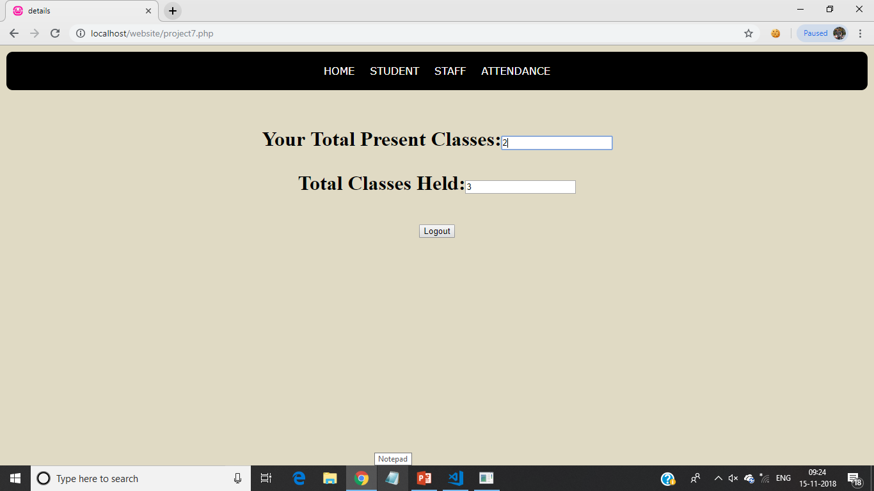
SNAPSHOTS (FRONTEND)

Slide 16
CONCLUSION
The project mainly focus on the total computerization of student details and faculty profile in which different levels of users are restricted to access the data. By restrictions we can restrict students to access the data but they can’t modify or update the database like student attendance and other information etc.
The project mainly operated by faculty. The faculty can insert the student entries and update the attendance of a particular section in a semester. This approach has features such as less manual intervation , data security is high and confidentially can be maintained.
The student can access the student’s attendance details within less time.

Slide 17
FUTURE ENHANCEMENTS
This project has a very vast scope in future.
The following are the future scope of project:
Bar code Reader based attendance system.
Individual attendance system with photo using student login.
The faculty can be used to know the attendance status to evaluate the performance of the students.
Timely attendance can be monitored.

Slide 18
REFERENCES
Websites
www.wiipedia.org
www.google.com
www.w3schools.com

Slide 19
THANKYOU

